Slide 1



2021 Priority Setting and
Resource Allocations

Slide 2
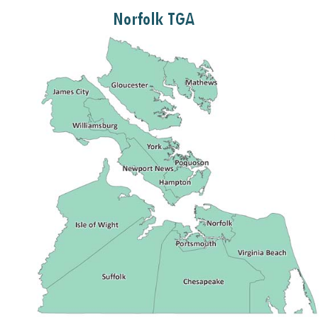
Norfolk TGA At-A-Glance
Who we serve:
Chesapeake
Norfolk
Virginia Beach
Portsmouth
Suffolk
Isle of Wight
Hampton
Poquoson
Newport News
Williamsburg
James City County
Gloucester County
Mathews County
York County
Currituck Co., NC
The Norfolk Transitional Grant Area (TGA) is comprised of 14 Cities/Counties in Virginia and one county in North Carolina. The TGA has an estimated population of 1,717,160. The TGA’s general population racial/ethic representation is 56% White/Caucasian, 30% Black/African American, 4% Multiracial, 4% Asian, and less than 1% combined for American Indians, Alaskan Natives, Native Hawaiians and/or Pacific Islanders. Approximately 7% of above races identify as being Hispanic or Latin in origin.
According to the US Census Bureau Quick Facts, the TGA’s poverty rate is 33% compared to 13.9% nationally. As of December 31, 2019, there were 7,831 PLWH, with 415 new HIV diagnoses in 2019. African American/Black non‐Hispanic communities continue to be disproportionately impacted by
HIV. Since 2015, HIV‐incidence among White non‐Hispanic decreased by 13.1% while African American/Black non‐Hispanic increased by 4.5%.
Census.gov. (2019). State and County QuickFacts. Quickfacts.census.gov. Retrieved 25 August 2020, from http://quickfacts.census.gov/qfd/index.html

Slide 3
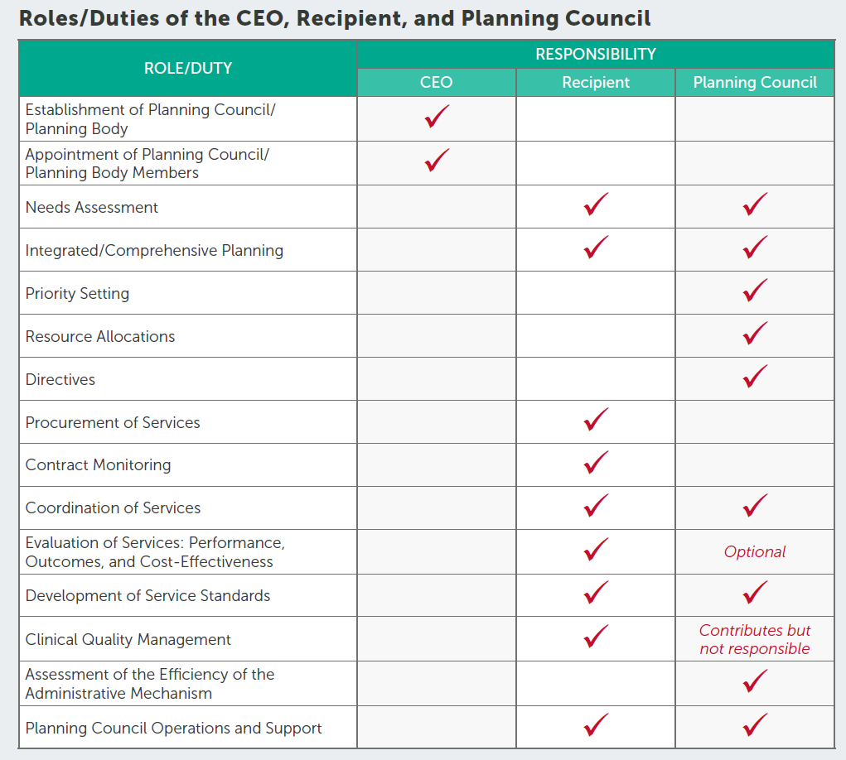
Norfolk TGA ROLES AND RESPONSIBILITIES
Based on needs assessment, utilization, and epidemiologic data— the Planning Council decides what services are most needed by people living with HIV in the TGA (priority setting) and decides how much RWHAP Part A money should be used for each of these service categories (resource allocations).
The planning council may also provide guidance to the recipient on service models, targeting of populations or service areas, and other ways to best meet the identified priorities (directives)
Ryan White HIV/AIDS Program Part A. Planning Council Primer. June 2018. JSI Research & Training Institute, Inc. in collaboration with EGM Consulting, LLC.

Slide 4
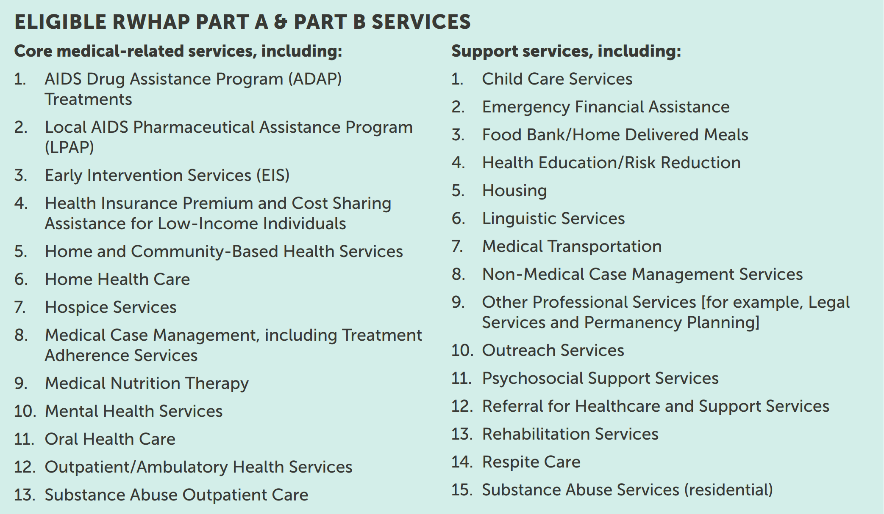
Norfolk TGA LEGISLATIVE REQUIREMENTS
The planning council uses needs assessment data as well as data from a number of other sources to set priorities and allocate resources. This means the members decide which services are most important to people living with HIV in the EMA or TGA (priority setting) and then agree on which service categories to fund and how much funding to provide (resource allocations). In setting priorities, the planning council should consider what service categories are needed to provide a comprehensive system of care for people living with HIV in the EMA or TGA, without regard to who funds those services.
The planning council must prioritize only service categories that are included in the RWHAP legislation as core medical services or support services. These are the same service categories that can be funded by RWHAP Part B and RWHAP Part C programs.
Ryan White HIV/AIDS Program Part A. Planning Council Primer. June 2018. JSI Research & Training Institute, Inc. in collaboration with EGM Consulting, LLC.

Slide 5
Norfolk TGA LEGISLATIVE REQUIREMENTS
After it sets priorities, the planning council must allocate resources, which means it decides how much RWHAP Part A funding will be used for each of these service priorities. For example, the planning council decides how much funding should go for outpatient/ ambulatory health services, mental health services, etc. In allocating resources, planning councils need to focus on the legislative requirement that at least 75 percent of funds must go to cover medical services and not more than 25 percent to support services, unless the EMA or TGA has obtained a waiver of this requirement. Support services must contribute to positive medical outcomes for clients. Typically, the planning council makes resource allocations using three scenarios that assume unchanged, increased, and decreased funding in the coming program year.
75%
Core
25%
Support
The planning council makes decisions about priorities and resource allocations based on many factors, including:
Needs assessment findings;
Information about the most successful and economical ways of providing services;
Actual service cost and utilization data (provided by the recipient);
Priorities of people living with HIV who will use services ;
Use of RWHAP Part A funds to work well with other services like HIV prevention and substance abuse treatment services, and within the changing healthcare landscape; and
The amount of funds provided by other sources like Medicaid, Medicare, state and local government, and private funders— since RWHAP is the “payor of last resort” and should not pay for services that can be provided with other funding.
Ryan White HIV/AIDS Program Part A. Planning Council Primer. June 2018. JSI Research & Training Institute, Inc. in collaboration with EGM Consulting, LLC.

Slide 6
Norfolk TGA Notice of funding opportunity
Funding Opportunity Number: HRSA-22-018
Funding Opportunity Type(s): Competing Continuation
Catalog of Federal Domestic Assistance (CFDA) Number: 93.914
Application Due Date: October 6, 2021
Funding Ceiling: $6,043,710.00
B. Planning Responsibilities
Section 2602(b)(4)(C) of the PHS Act requires PCs/PBs to determine the priority for RWHAP allowable services and service allocations of RWHAP Part A funds every year. To fulfill this responsibility, EMA/TGA PCs/PBs set service priorities and allocate RWHAP Part A funds based on the size, demographics, and needs of people with or affected by HIV, with particular focus on individuals who know their HIV status but are not in care. The RWHAP Part A PCs/PBs also are responsible for evaluating the efficiency of the recipient in distributing funds to service providers.
PCs/PBs analyze information to develop an in-depth understanding of the current HIV epidemic and its impact on the service area. PCs/PBs review needs assessment data, HIV epidemiologic data, and co-occurring conditions data. The review includes service utilization data related to complexity of providing care, including service availability and unit cost per service, as well as service needs of emerging populations. The purpose of these data reviews is to guide decisions about HIV-related services and resources in the EMA/TGA. Furthermore, planning and implementation of the RWHAP Part A is driven by overall comprehensive planning and the recently developed Integrated HIV Prevention and Care Plan, including the Statewide Coordinated Statement of Need, Calendar Year (CY) 2017-2021 as a roadmap for relevant goals, objectives, and strategies for delivering RWHAP Part A services along the HIV care continuum. Locally developed Ending the HIV Epidemic plans, where available, might also serve as a valuable roadmap.

Slide 7
Norfolk TGA PSRA Procedure
Planning and Resource Allocation
The purpose of this section is to document the existence of a functioning planning process in the EMA/TGA that is consistent with RWHAP and HRSA program requirements. Section 2602(b)(1)-(4) of the PHS Act delineates the responsibilities of the PC/PB. A planning process is imperative for effective local and state decision making to develop systems of prevention and care that are responsive to the needs of persons at risk for HIV and people with HIV. HRSA and CDC support activities that facilitate collaboration and/or develop a joint planning body to address prevention and care. Community engagement is an essential component for planning comprehensive, effective HIV prevention and care programs in the United States.
The composition of the PC/PB must reflect the demographics of the HIV epidemic in the EMA/TGA and be representative of various required categories of membership as cited in Sec. 2602(b)(1)-(2) of the PHS Act. PC/PB members must be trained regarding their legislatively mandated responsibilities and other competencies necessary for full participation in collaborative decision-making. PCs/PBs are encouraged to educate members about service issues related to the prevention of intimate partner violence, opioid and other drug use, and trauma-informed care as part of their ongoing training. PCs/PBs should also consider recruiting members who are knowledgeable about these issues.
1
STAGE 1
Planning and
Resource Allocation

Slide 8
Norfolk TGA PSRA Procedure
Planning and Resource Allocation
Priority Setting and Resource Allocation (PSRA):
  Data (e.g., comprehensive needs assessment, HIV care continuum, unmet need framework estimates, and epi profile) were used in the FY 2022 priority setting and allocations process to ensure that:
    Needs of the populations with HIV (including those with unmet need for HIV-related services, disparities in access and services among affected subpopulations and historically underserved communities, and those unaware of their HIV status) are addressed.
    Resources were allocated in accordance with the local demographic incidence of AIDS including appropriate allocations for services for women infants, children, and youth
  People with HIV were involved in the planning and allocation processes and how their priorities were considered in the process
  FY 2021 period of performance formula, supplemental, and MAI funds awarded to the EMA/TGA were expended according to the priorities established by the PC or PB
1
STAGE 1
Planning and
Resource Allocation

Slide 9
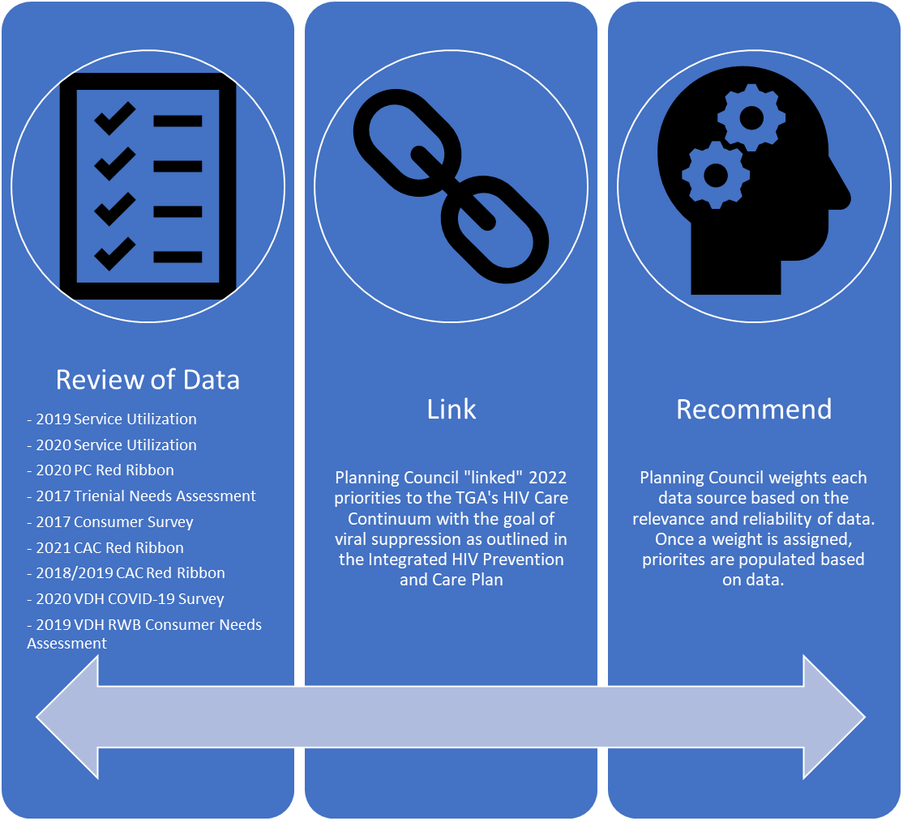
Norfolk TGA PSRA Procedure
1
STAGE 1
Planning and
Resource Allocation
2022/23 Priority Setting Process – Norfolk TGA

Slide 10
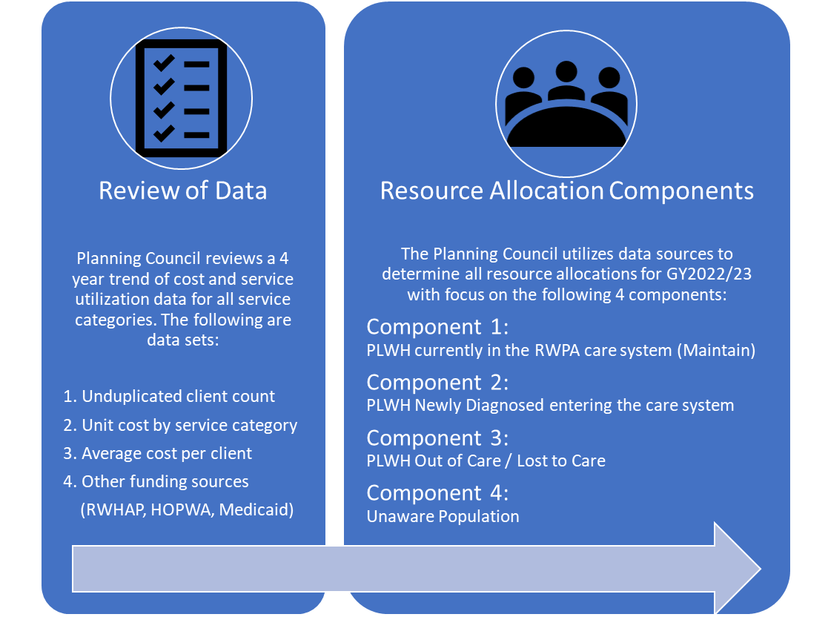
Norfolk TGA PSRA Procedure
1
STAGE 1
Planning and
Resource Allocation
2022/23 Priority Setting Process – Norfolk TGA

Slide 11
Norfolk TGA PSRA Procedure
Description of the Community Input Process
Describe the overall community input process and how it informs the PC/PB priority setting and resource allocation process for the jurisdiction and include a summary of how the process was conducted. Also, include a discussion of how the input process has helped inform the RWHAP Part A service priorities and resource allocations, as well as a description of how the input process is interwoven into your RWHAP Part A activities.
Specifically, address:
How people with HIV were involved in the planning and allocation processes and how their priorities were considered in the process;
How the input of the community was considered and whether the community input process adequately addressed any funding increases or decreases in the RWHAP Part A award;
How MAI funding was considered during the planning process to enhance services to minority populations;
How data were used in the priority setting and allocation processes to increase access to core medical services, ensure access to services for women, infants, children, and youth (WICY) and to reduce disparities in access to HIV care in the EMA/TGA; and
Any significant changes in the prioritization and allocation process from 2019 to 2020 project periods and the rationale for making those changes.
2
STAGE 2
Description of the
Community Input Process

Slide 12

Norfolk TGA PSRA Procedure
2
STAGE 2
Description of the
Community Input Process

Slide 13

REVIEW OF DATA

Slide 14
Norfolk TGA EPIDEMOLOGICAL DATA
HIV
2%
INCIDENCE
Since 2012
AIDS
8%
INCIDENCE
Since 2012
Data as of July 2020; Accessed August 2020, Division of Disease Prevention, Virginia Department of Health

Slide 15
Norfolk TGA EPIDEMOLOGICAL DATA
HIV
28%
PREVALANCE
Since 2012
AIDS
18%
PREVALANCE
Since 2012
Data as of July 2020; Accessed August 2020, Division of Disease Prevention, Virginia Department of Health

Slide 16
Norfolk TGA EPIDEMOLOGICAL DATA
TOTAL
21%
CASES
Since 2012
Data as of July 2020; Accessed August 2020, Division of Disease Prevention, Virginia Department of Health

Slide 17

Norfolk TGA EPIDEMOLOGICAL DATA
Age at Diagnosis (Years) Age at Diagnosis (Incidence) and Current Age (Prevalence) | 2019 Total Cases
<13 years | 9
13 - 19 years | 57
20 - 44 years | 3,411
45 + years | 4,354
Unknown | 0
Total | 7,831
TOTAL
CASES - Age
Data as of July 2020; Accessed August 2020, Division of Disease Prevention, Virginia Department of Health

Slide 18

Norfolk TGA EPIDEMOLOGICAL DATA
Race/Ethnicity | 2019 Total Cases
White, not Hispanic | 1,724
African-American, not Hispanic | 5,364
Hispanic/Latino (all races) | 411
Asian/Hawaiian/Pacific Islander | 61
American Indian/Alaska Native | 11
Multi-race /Other/ Unknown | 260
Total | 7,831
TOTAL
CASES –
Race/Ethnicity
Data as of July 2020; Accessed August 2020, Division of Disease Prevention, Virginia Department of Health

Slide 19





Norfolk TGA EPIDEMOLOGICAL DATA
Age at Diagnosis (Years) Age at Diagnosis (Incidence) and Current Age (Prevalence) | 2019 Total Cases
Male | 5,808
Female | 2,023
Total | 7,831
TOTAL
CASES –
Gender
Data as of July 2020; Accessed August 2020, Division of Disease Prevention, Virginia Department of Health
74%
26%
MALE
FEMALE

Slide 20
Norfolk TGA EPIDEMOLOGICAL DATA
Exposure Category | 2019 Total Cases
Men who have sex with men | 3,822
Injection drug users | 527
Men who have sex with men and inject drugs | 246
Heterosexuals | 1,342
Blood recipient (Receipt of blood transfusion/transplant, Adult received clotting factor) | 56
Risk not reported or identified | 1,250
Pediatric (perinatal exposure, child received transfusion/transplant, child received clotting factor, child with no reported or identified risk | 588
Total | 7,831
TOTAL
CASES –
Method of Exposure
Data as of July 2020; Accessed August 2020, Division of Disease Prevention, Virginia Department of Health

Slide 21


Norfolk TGA SERVICE UTILIZATION DATA
EIS
Early Intervention Services
Minority AIDS Initiative
2021 Ranking | 2020 Ranking | 2019 Ranking
12 | 12 | 15
Data as of July 2020; Accessed July 2020, Ryan White Part A CAREWare, City of Norfolk
20177
17%
2017
56%
2020
90%
2020
2020
2017
TOTAL EXPENDED
TOTAL CLIENTS SERVED
COST PER CLIENT

Slide 22
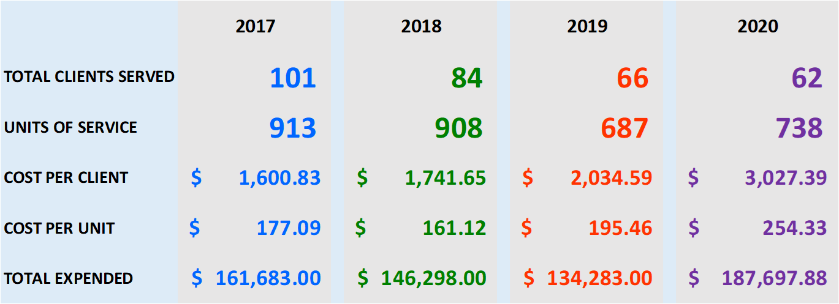
Norfolk TGA SERVICE UTILIZATION DATA
2021
Ranking
EIS
Early Intervention Services
REGULAR
2021 Ranking | 2020 Ranking | 2019 Ranking
12 | 12 | 15
Data as of July 2020; Accessed July 2020, Ryan White Part A CAREWare, City of Norfolk
16%
2017
39%
89%
2020
2020
2017
2020
2017
TOTAL EXPENDED
TOTAL CLIENTS SERVED
COST PER CLIENT

Slide 23

Norfolk TGA SERVICE UTILIZATION DATA
OAHS
Outpatient Ambulatory
Health Services
2021 Ranking | 2020 Ranking | 2019 Ranking
2 | 3 | 1
Data as of July 2020; Accessed July 2020, Ryan White Part A CAREWare, City of Norfolk
1%
2017
53%
2020
116%
2020
2017
2020
2017
TOTAL EXPENDED
TOTAL CLIENTS SERVED
COST PER CLIENT

Slide 24

Norfolk TGA SERVICE UTILIZATION DATA
MCM
Medical Case
Management Services
2021 Ranking | 2020 Ranking | 2019 Ranking
1 | 5 | 5
Data as of July 2020; Accessed July 2020, Ryan White Part A CAREWare, City of Norfolk
5%
5%
11%
2020
2020
2020
2017
2017
2017
TOTAL EXPENDED
TOTAL CLIENTS SERVED
COST PER CLIENT

Slide 25

Norfolk TGA SERVICE UTILIZATION DATA
HIPCSA
Health Insurance Premium
and Cost Sharing Assistance
2021 Ranking | 2020 Ranking | 2019 Ranking
6 | 7 | 6
Data as of July 2020; Accessed July 2020, Ryan White Part A CAREWare, City of Norfolk
2017
32%
52%
42%
2017
2020
2020
2020
2017
TOTAL EXPENDED
TOTAL CLIENTS SERVED
COST PER CLIENT

Slide 26

Norfolk TGA SERVICE UTILIZATION DATA
LPAP
Local Pharmaceutical
Assistance Program
2021 Ranking | 2020 Ranking | 2019 Ranking
13 | 13 | 13
2017
95%
2017
71%
2017
84%
2020
2020
2020
TOTAL EXPENDED
TOTAL CLIENTS SERVED
COST PER CLIENT

Slide 27


Norfolk TGA SERVICE UTILIZATION DATA
MH
Mental Health Services
2021 Ranking | 2020 Ranking | 2019 Ranking
3 | 1 | 3
Data as of July 2020; Accessed July 2020, Ryan White Part A CAREWare, City of Norfolk
2017
39%
2017
77%
159%
2020
2020
2020
2017
TOTAL EXPENDED
TOTAL CLIENTS SERVED
COST PER CLIENT

Slide 28

Norfolk TGA SERVICE UTILIZATION DATA
SA
Substance Abuse Services-
Outpatient
2021 Ranking | 2020 Ranking | 2019 Ranking
11 | 4 | 8
Data as of July 2020; Accessed July 2020, Ryan White Part A CAREWare, City of Norfolk
2016
72%
2016
75%
2019
12%
2019
2019
2016
TOTAL EXPENDED
TOTAL CLIENTS SERVED
COST PER CLIENT

Slide 29

Norfolk TGA SERVICE UTILIZATION DATA
OH
Oral Health Services
2021 Ranking | 2020 Ranking | 2019 Ranking
10 | 9 | 9
Data as of July 2020; Accessed July 2020, Ryan White Part A CAREWare, City of Norfolk
2017
23%
2017
55%
2020
69%
2020
2020
2017
TOTAL EXPENDED
TOTAL CLIENTS SERVED
COST PER CLIENT

Slide 30

Norfolk TGA SERVICE UTILIZATION DATA
NMCM
Non-Medical Case Management
2021 Ranking | 2020 Ranking | 2019 Ranking
9 | 11 | 11
Data as of July 2020; Accessed July 2020, Ryan White Part A CAREWare, City of Norfolk
2017
11%
82%
77%
2017
2017
2020
2020
2020
TOTAL EXPENDED
TOTAL CLIENTS SERVED
COST PER CLIENT

Slide 31


Norfolk TGA SERVICE UTILIZATION DATA
EFA
Emergency Financial
Assistance
2021 Ranking | 2020 Ranking | 2019 Ranking
8 | 10 | 7
Data as of July 2020; Accessed July 2020, Ryan White Part A CAREWare, City of Norfolk
11%
2017
23%
44%
2020
2020
2017
2020
2017
TOTAL EXPENDED
TOTAL CLIENTS SERVED
COST PER CLIENT

Slide 32


Norfolk TGA SERVICE UTILIZATION DATA
MT
Medical Transportation
Services
2021 Ranking | 2020 Ranking | 2019 Ranking
4 | 2 | 2
Data as of July 2020; Accessed July 2020, Ryan White Part A CAREWare, City of Norfolk
22%
35%
20%
2017
2017
2020
2020
2020
2017
TOTAL EXPENDED
TOTAL CLIENTS SERVED
COST PER CLIENT

Slide 33


Norfolk TGA SERVICE UTILIZATION DATA
FB
Food Bank /
Home Delivered Meals
2021 Ranking | 2020 Ranking | 2019 Ranking
5 | 8 | 10
Data as of July 2020; Accessed July 2020, Ryan White Part A CAREWare, City of Norfolk
160%
58%
65%
2020
2020
2020
2017
2017
2017
TOTAL EXPENDED
TOTAL CLIENTS SERVED
COST PER CLIENT

Slide 34
Norfolk TGA SERVICE UTILIZATION DATA
RHSS
Referral for Healthcare and Support Services
2021 Ranking | 2020 Ranking | 2019 Ranking
16 | 26 | 26
Data as of July 2020; Accessed July 2020, Ryan White Part A CAREWare, City of Norfolk
241%
38%
147%
2019
2019
2019
2017
2017
2017
TOTAL EXPENDED
TOTAL CLIENTS SERVED
COST PER CLIENT

Slide 35
Questions?

